Slide 1

Build Your Own Portfolio Website
BY : Anjali Sharma

Slide 2
Task Description
Create a personal portfolio web page using only HTML and CSS, inspired by the layout provided. Your portfolio should include:
A navigation bar with clickable links (use #sectionID).
An "About Me" section with your name, a short paragraph, and a profile image.
A "Skills" section with cards showing your skills, levels, and logos.
An "Achievements" section with certificates or descriptions.
A "Projects" section to showcase 2-3 mini projects.
An "Education" section with course details.
A "Contact" section with working links and icons (social media, email).
Let’s check it out ……

Slide 3
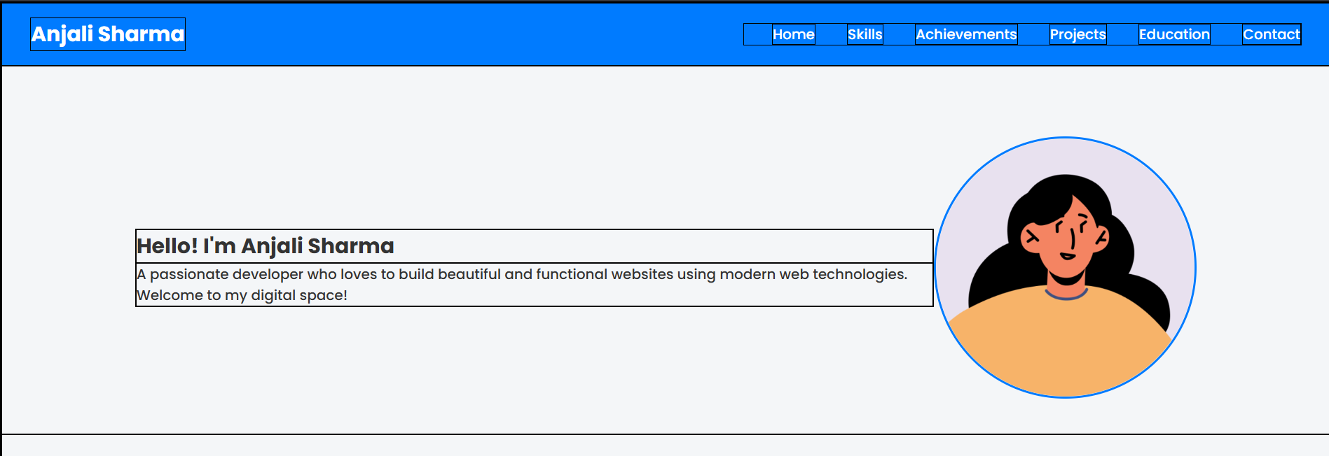
Navigation Bar
Purpose: Helps users scroll to various sections of the portfolio using links.
Key Concepts: Flexbox layout, anchor linking (href="#section-id")
Styling: Blue background, white text, hover effect with yellow.

Slide 4
Introduction Section
purpose: Displays user’s name, description, and a profile image.
Layout: Flexbox with intro-text on the left and an image on the right.
Image Used: “ https://avatar.iran.liara.run/public/girl ”

Slide 5
Skills Section
Purpose: Shows a grid of technical skills write there name with their level.
Layout: use CSS Grid or Flexbox property.
For logos use these urls :
HTMLhttps://img.icons8.com/color/96/html-5.png
JavaScripthttps://img.icons8.com/color/96/javascript.png
Javahttps://img.icons8.com/color/96/java-coffee-cup-logo.png
MySQLhttps://img.icons8.com/color/96/mysql-logo.png
Bootstraphttps://img.icons8.com/color/96/bootstrap.png
Pythonhttps://img.icons8.com/color/96/python.png

Slide 6
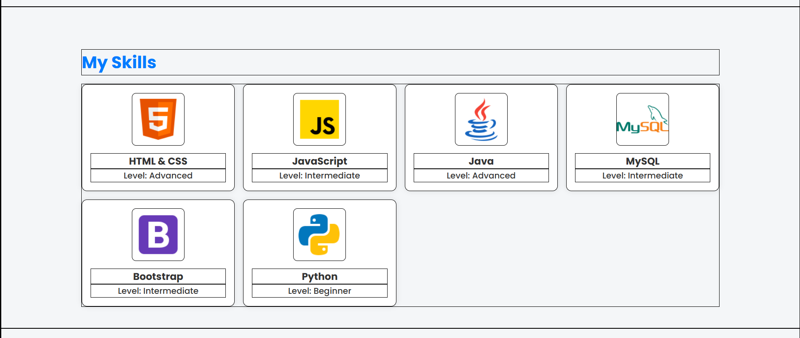

Slide 7
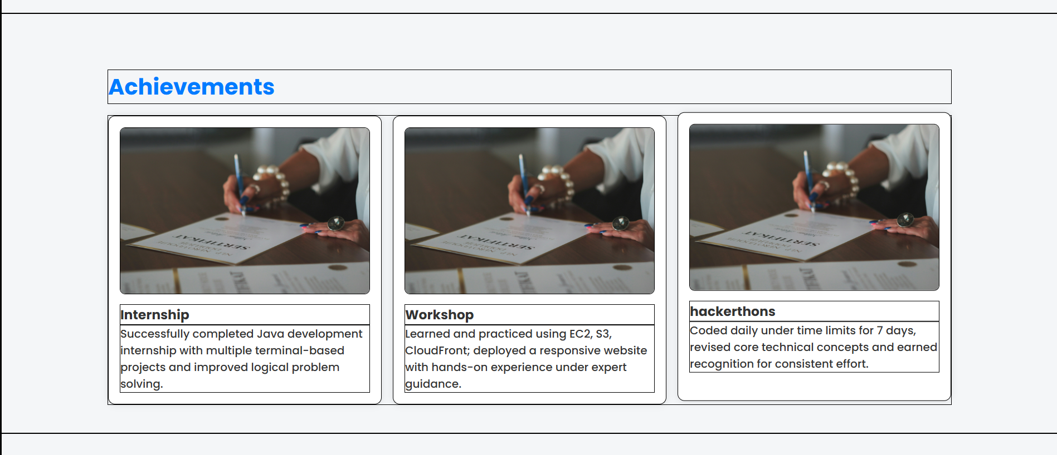
Achievements Section
Purpose: Displays completed internships or workshops or challenges etc.
Layout: Card design with an image, title, and paragraph.
Image Used: Same placeholder image (certificate.jpg) for simplicity.

Slide 8
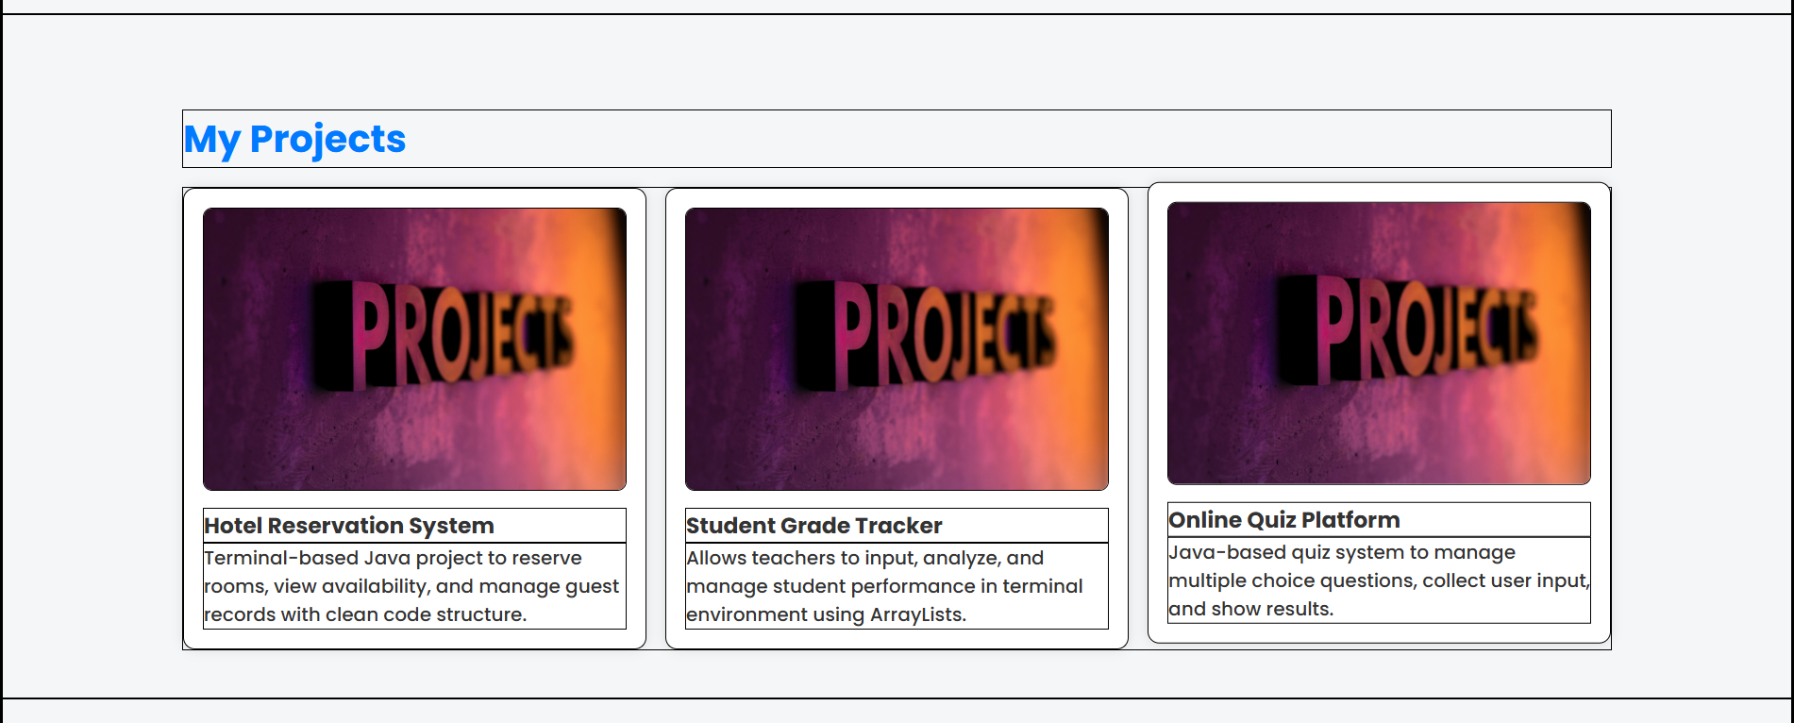
Project Showcase
Purpose: Lists personal or academic projects with images.
Layout: Grid of cards similar to skills/achievements.
Image Used: Placeholder image (project img.jpg).

Slide 9
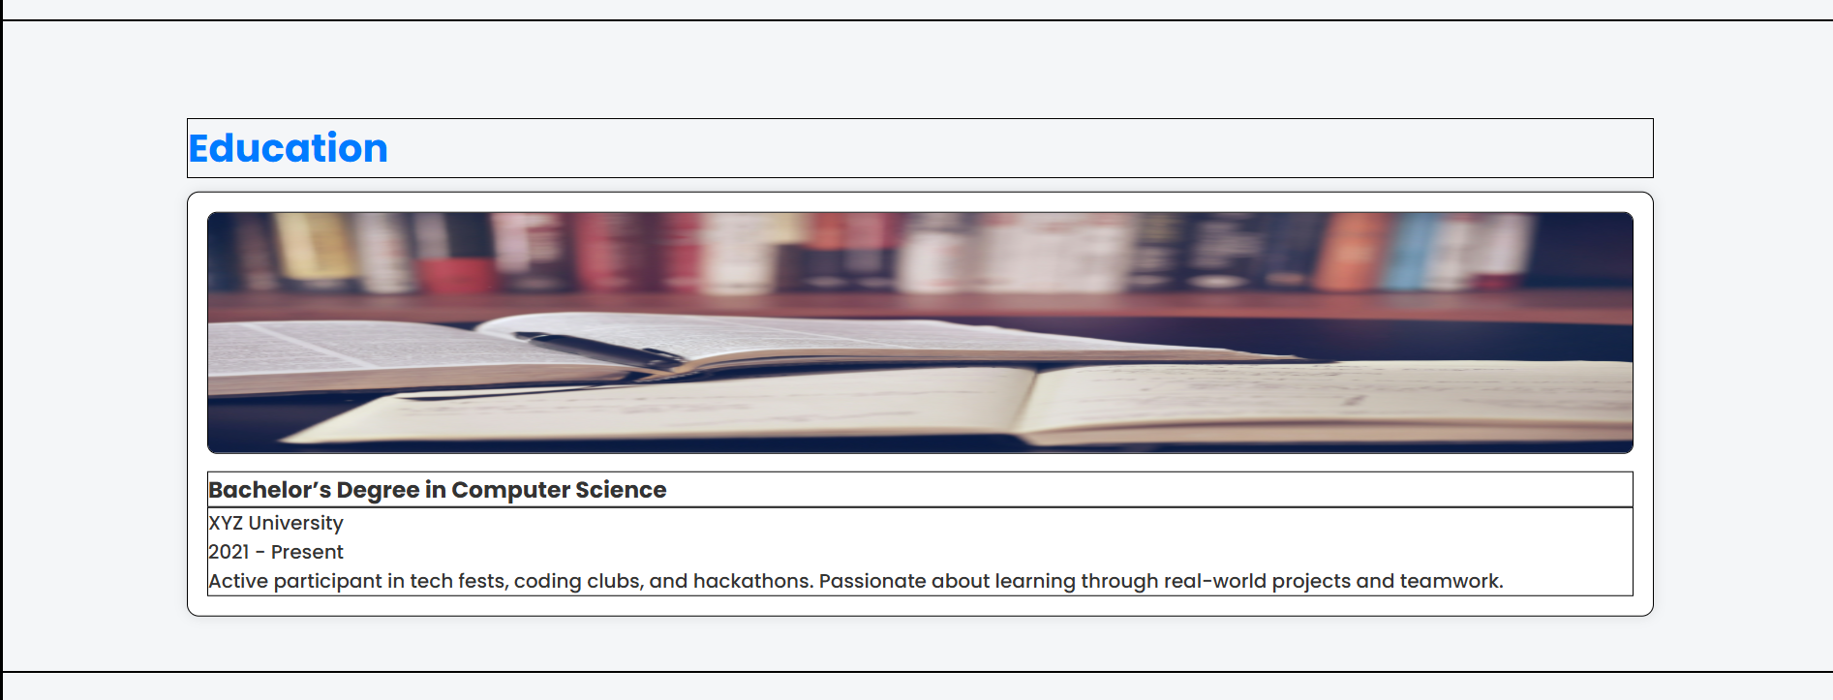
Education Background
Purpose: Shows educational background, institution, year.
Layout: Card with an education-related image and paragraph.
Image Used: studyimg.jpg.

Slide 10
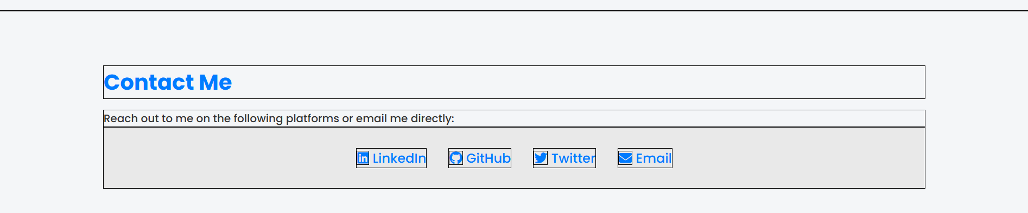
Contact Section
Purpose: Contains social media and email links.
Icons: Font Awesome icons (LinkedIn, GitHub, Twitter, Email).

Slide 11
Final Look of Website

Slide 12

THANK YOU
ALL THE BEST

